Slide 1
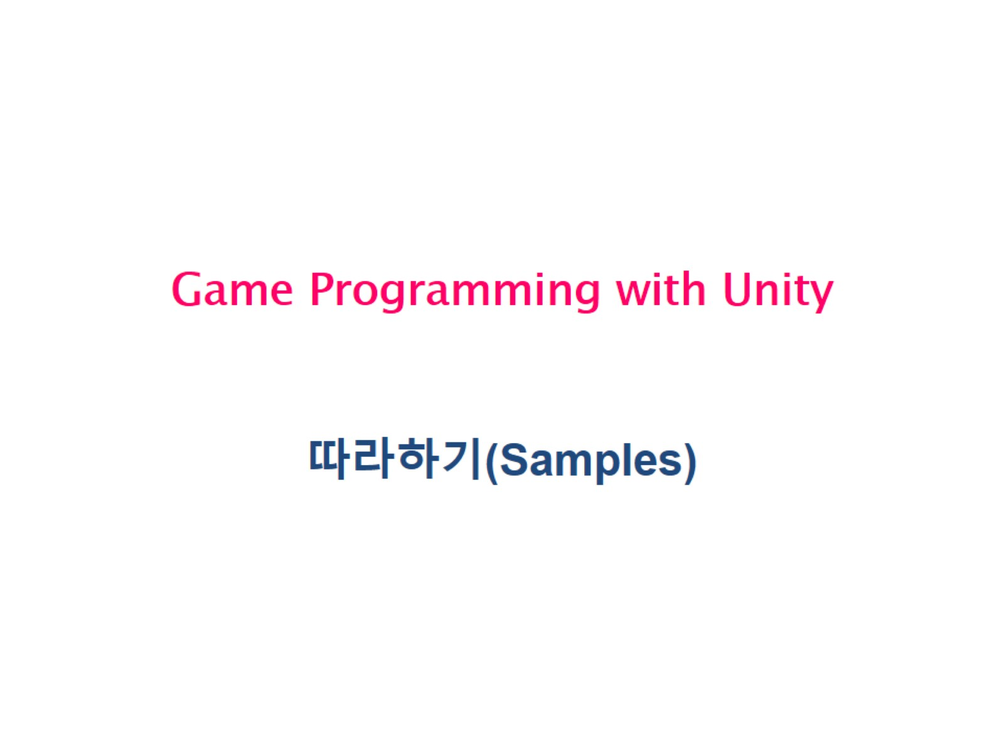
Game Programming with Unity

Slide 2
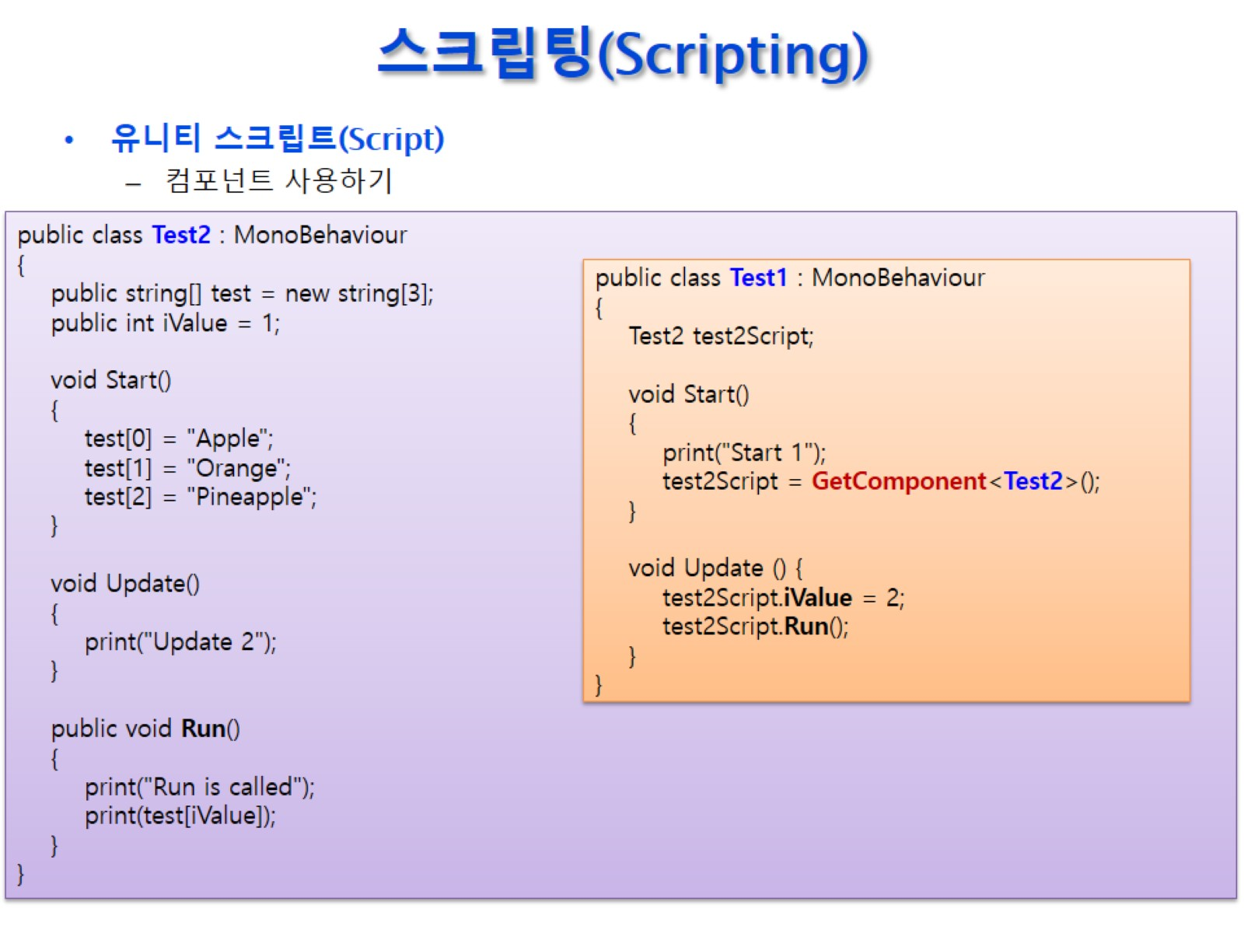
스크립팅(Scripting)

Slide 3
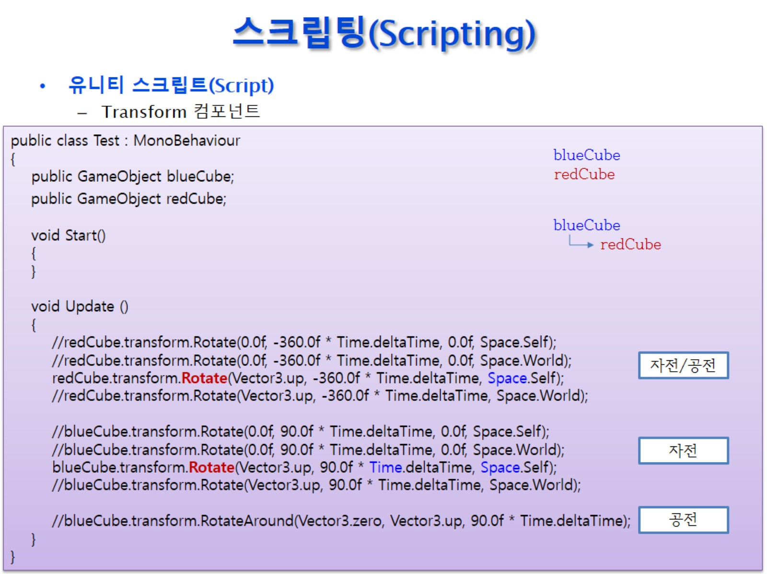
스크립팅(Scripting)

Slide 4
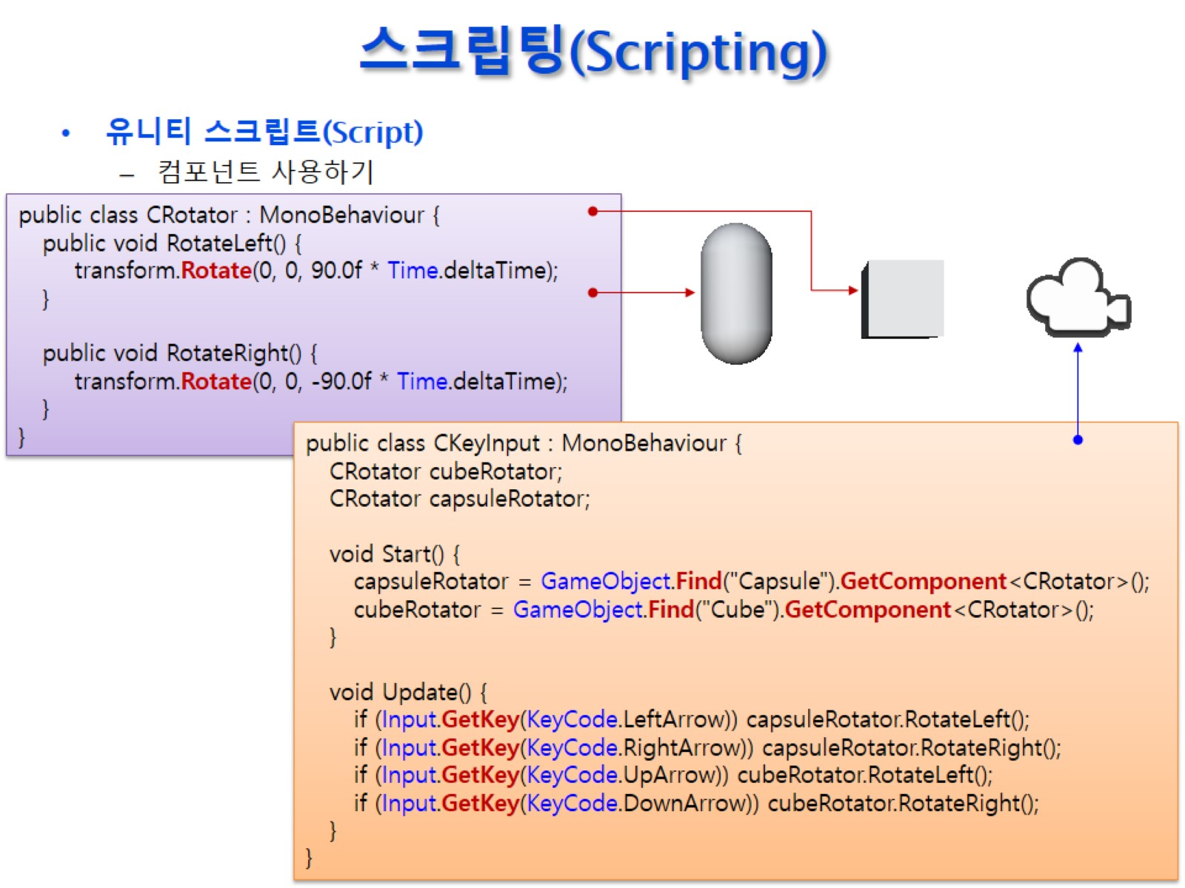
스크립팅(Scripting)

Slide 5
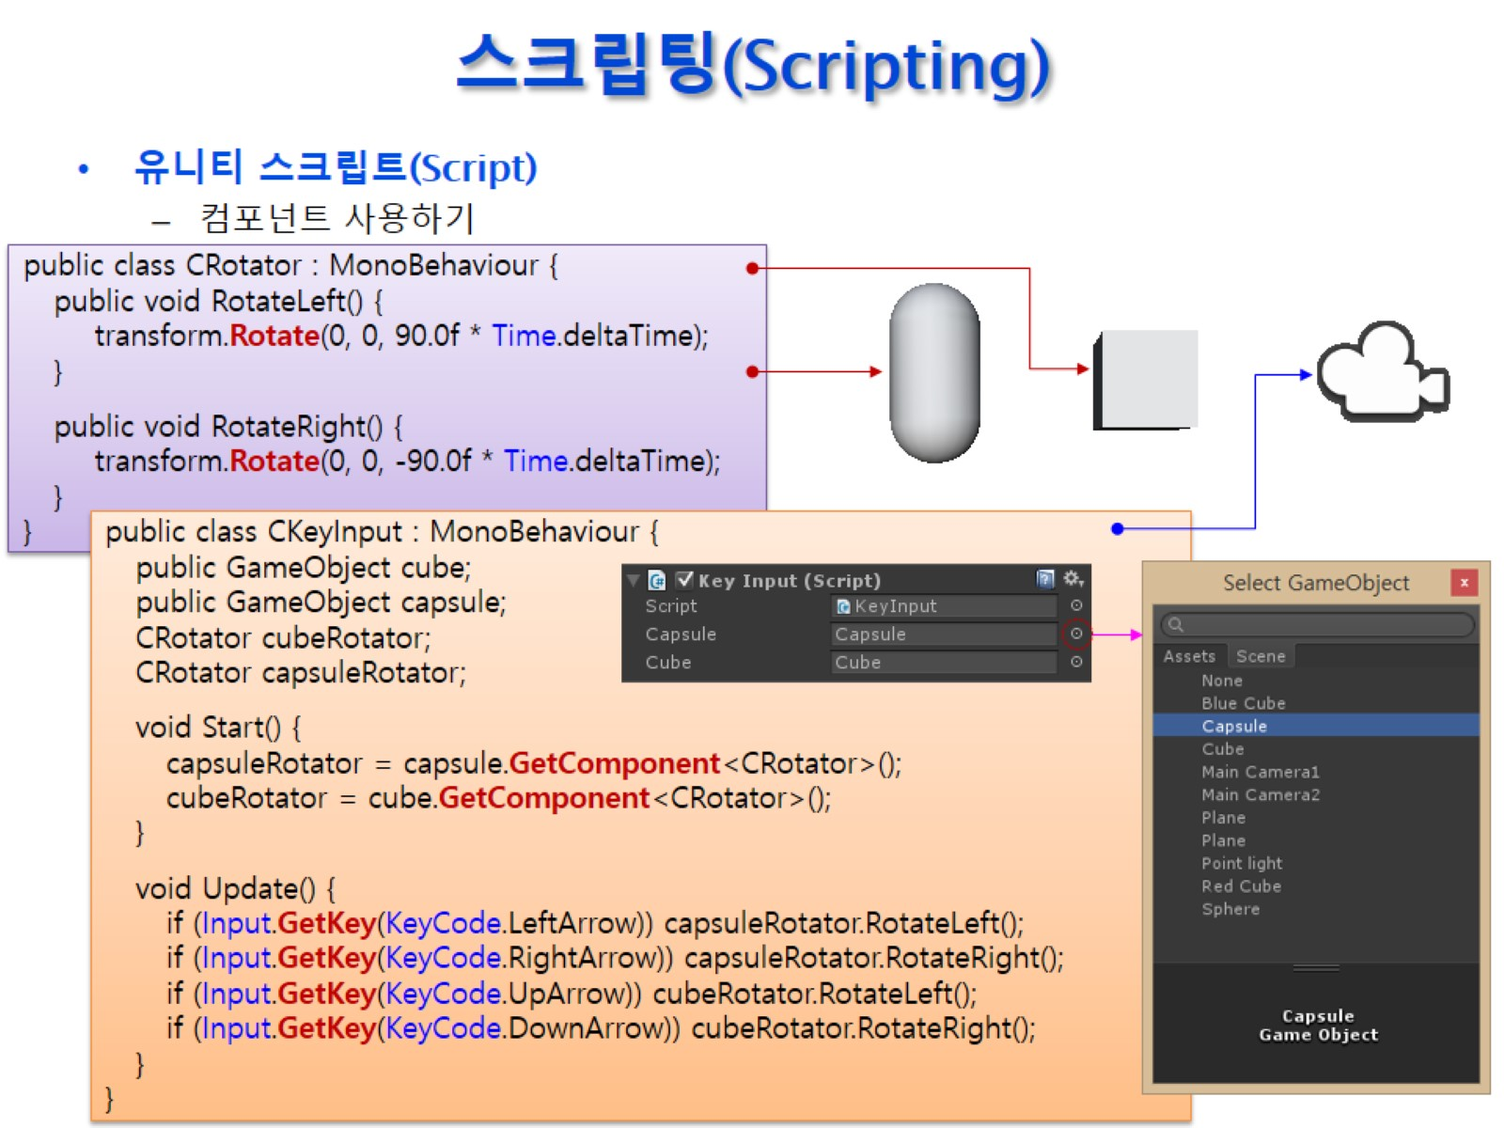
스크립팅(Scripting)

